Slide 1


Better Health, Lower Costs For Everyone
A.I. Activation in Healthcare
2026 Sales Kickoff
Confidential and Proprietary

Slide 2

Agenda
Why we need a new way to access care
How we use A.I. / LLMs to drive Engagement & Outcomes
Demo
Real-world results
Next steps
Notes:
Challenge, “the problem to solve”

Slide 3





Introductions
Steve Parker
Senior Vice President
Amy Osterhagen
Vice President
Ellen Geraghty
Vice President

Slide 4
Why do
40,000,000 people a day
go to ChatGPT with health questions?

Slide 5
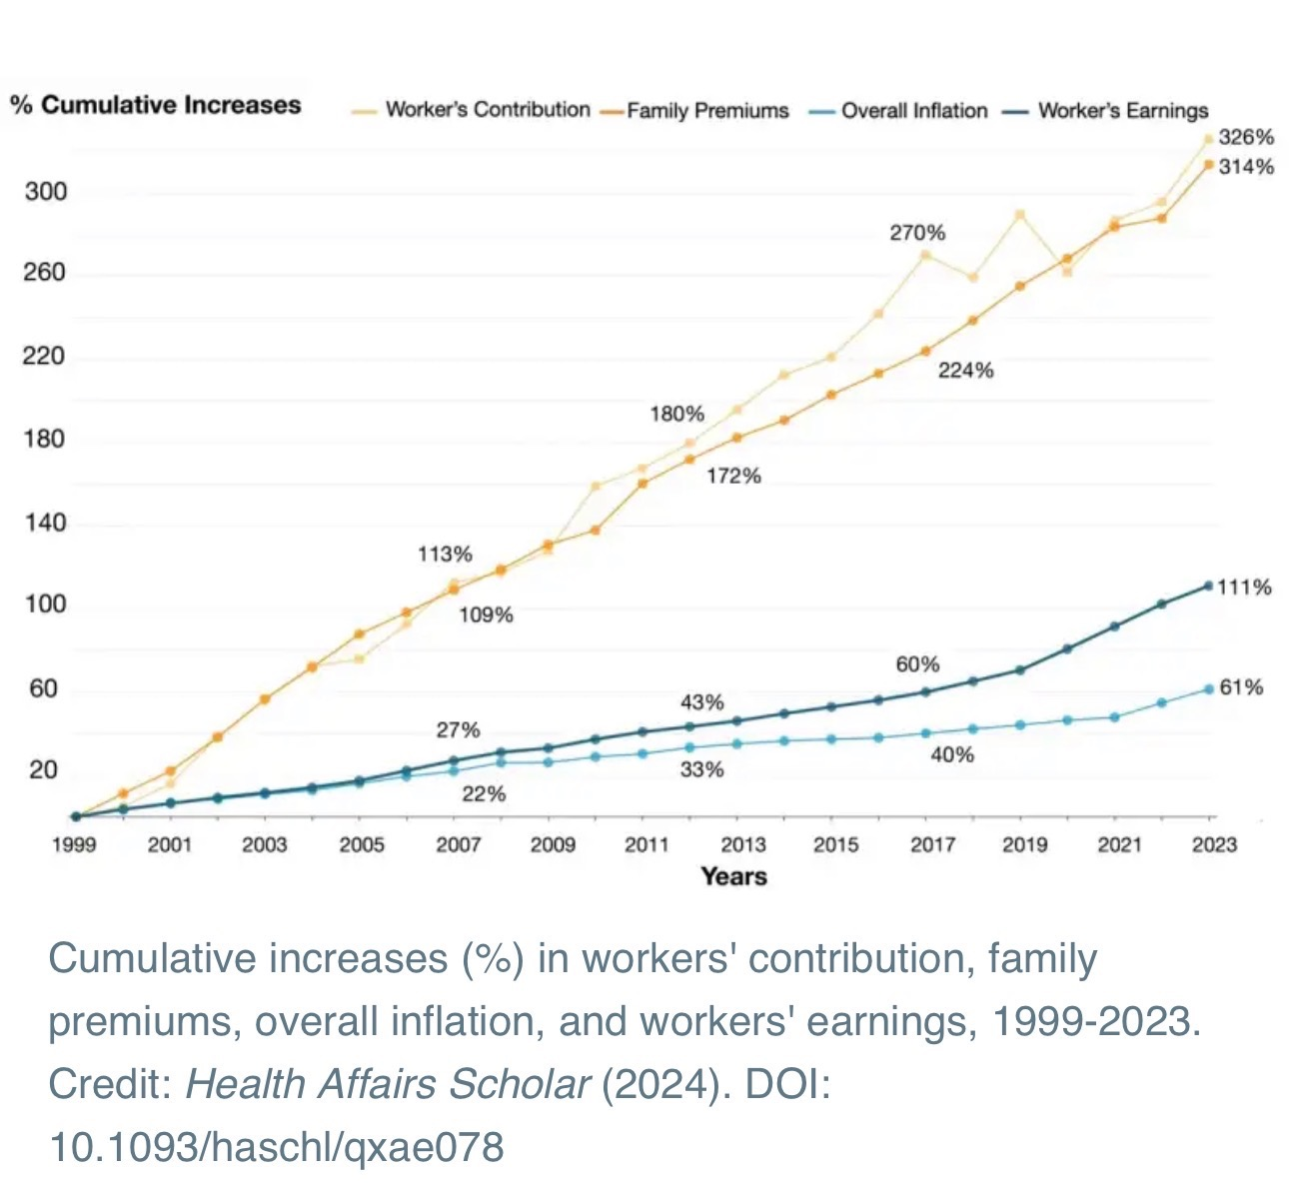
Healthcare costs are on pace to double… again
Health Affairs Scholar 2026
Notes:
Challenge/what’s broken:
Employers are facing another year of elevated cost increases, driven by medical + Rx.
Traditional levers are tapped out leading to diminishing returns and more member friction at renewal.
Affordability and talking about the impact of that. Deferring care. How rate increases have contributed to the problem around affordability.

Slide 6
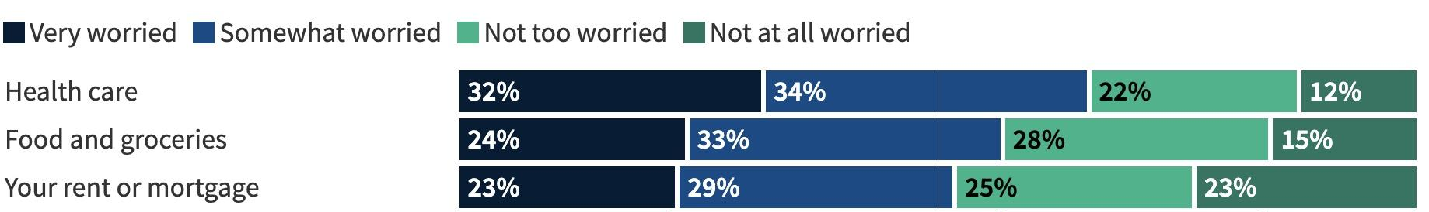
Healthcare affordability is now the #1 concern for most (66%) of your employees
Kaiser Family Foundation Jan 2026
Notes:
Challenge/what’s broken:
Employers are facing another year of elevated cost increases, driven by medical + Rx.
Traditional levers are tapped out leading to diminishing returns and more member friction at renewal.
Affordability and talking about the impact of that. Deferring care. How rate increases have contributed to the problem around affordability.

Slide 7
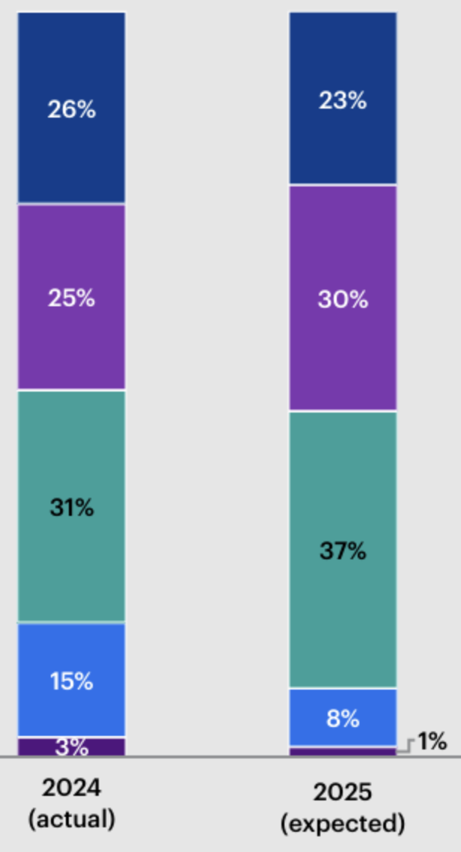
53% of employers are above or significantly above their healthcare budgets
Significantly Above Budget
Even after trying:
Higher Deductibles
Higher Co-pays
Narrower networks
Restricted formularies
More point solutions
Above Budget
At Budget
Below Budget
Significantly Below Budget
Notes:
Challenge/what’s broken:
Employers are facing another year of elevated cost increases, driven by medical + Rx.
Traditional levers are tapped out leading to diminishing returns and more member friction at renewal.
Affordability and talking about the impact of that. Deferring care. How rate increases have contributed to the problem around affordability.

Slide 8
Healthcare trend is high >9%,
Employee engagement is low <5%

Slide 9
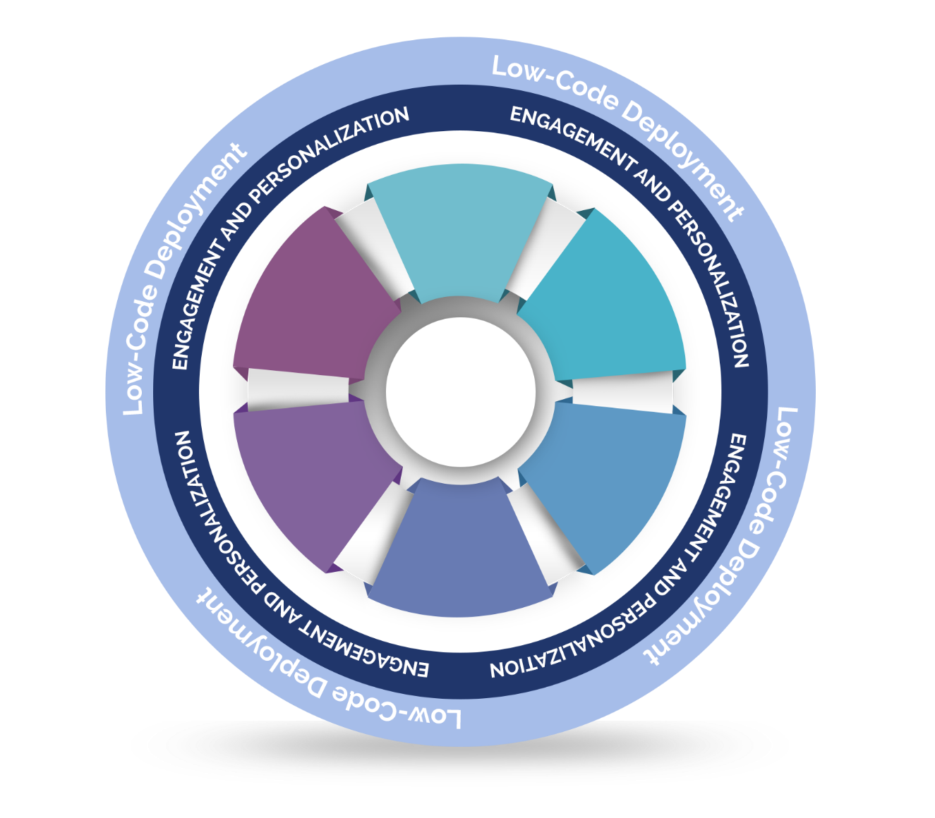
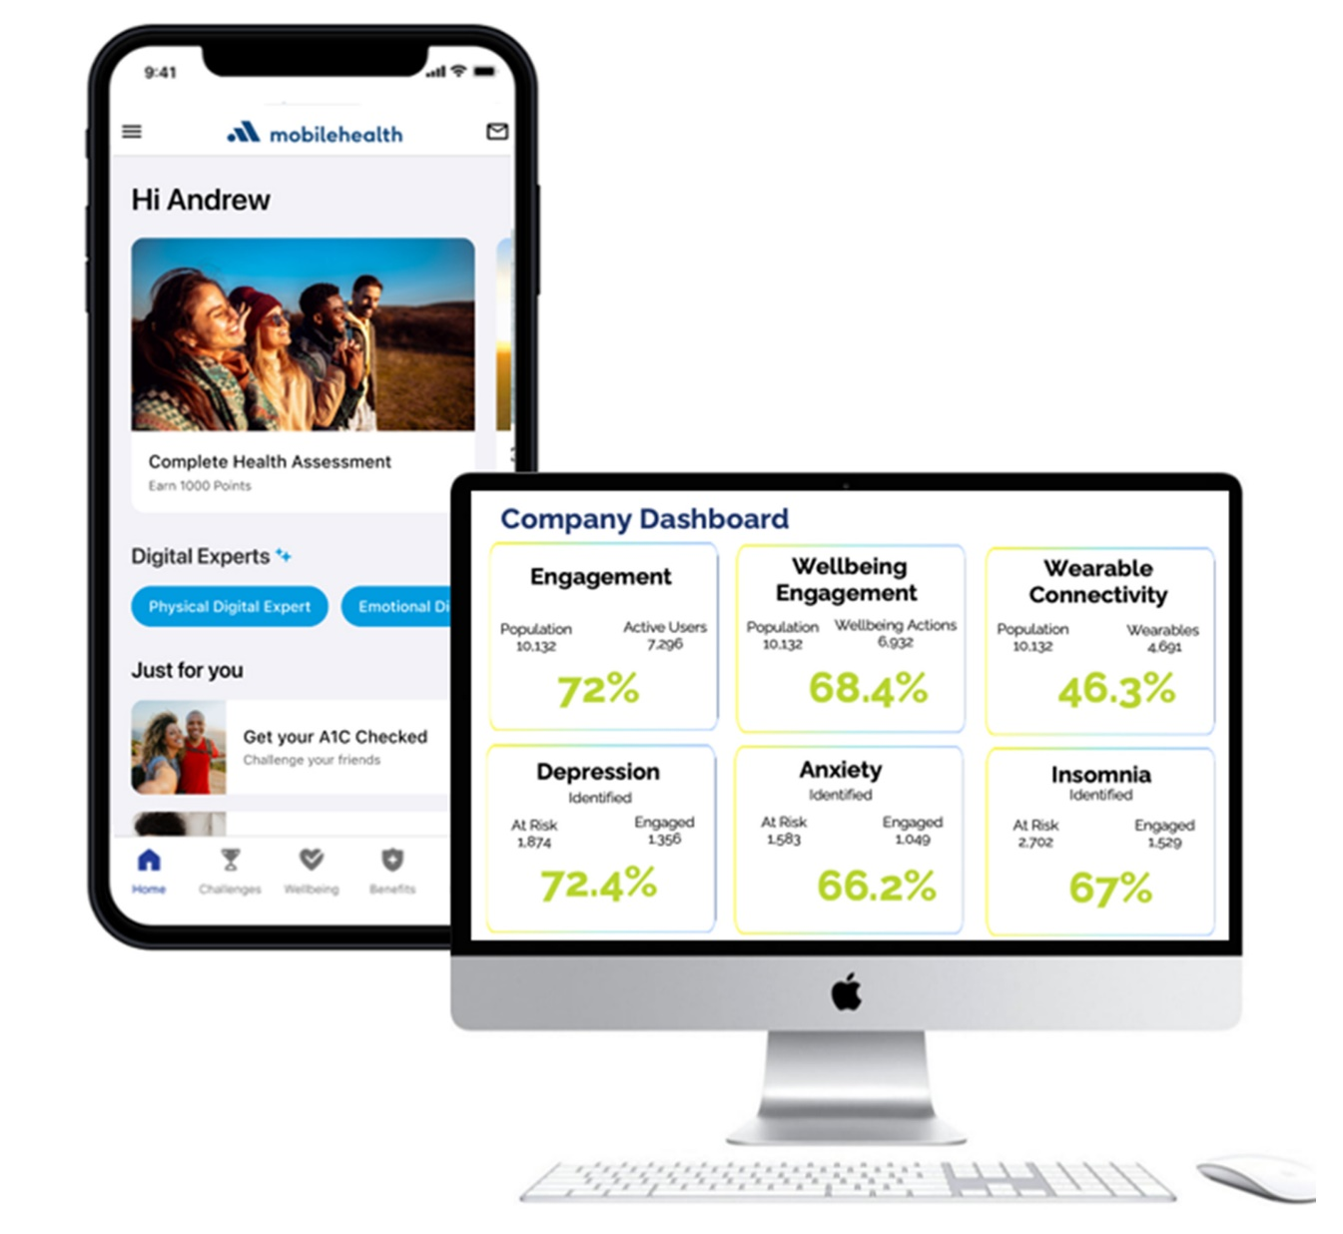







One Comprehensive Platform
Communications /
Reminders
Incentives /
Marketplace
Challenges
Digital
Care Paths
Personalized
Digital
Coaching
Holistic
Wellbeing
Programs
Rapid Deployment: 30-90 days
Easy to Change: 10-30 days

Slide 10





AI-powered LLMs: The New Front Door to Health Information
40M
people a day turn to ChatGPT for health questions -
largely driven by the need for accessibility and affordability.
Chat GPT
Generic content
Personalized
Generic tips
Internet scraping
No health data integration
Long-form responses
Generic safety filters
No clinical methodologies
Broad, generalized domain
General guidance
Personalized, user specific
Evidence-based, clinical
Health data integration
Bite-size, easy steps
Crisis routing and vetted scripts
Motivational Interviewing
Specialized agents by topic
Designed for measurable outcomes

Slide 11

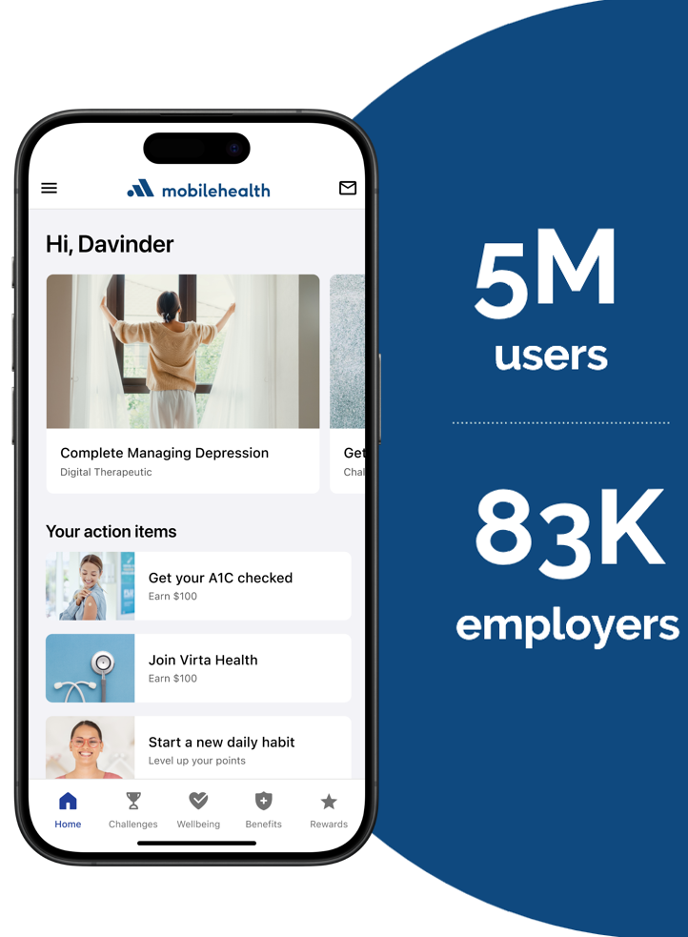



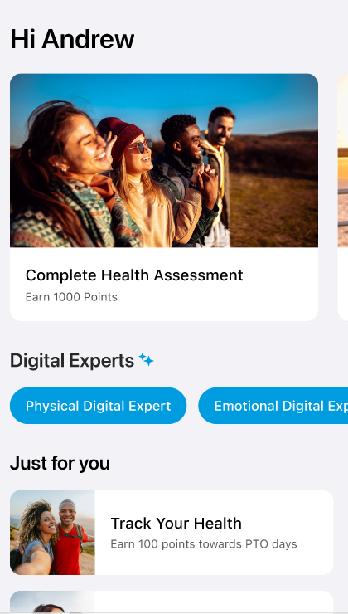











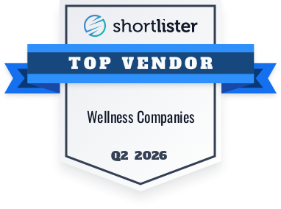








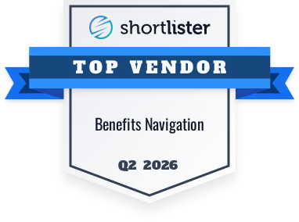




Who we are
6m
users
95K
employers
Confidential and Proprietary

Slide 12
Mobile Health Solutions
 | Engagement | Cost Management | Engagement Based Pricing
Wellbeing & Rewards | ✔ | ✔ | ✔
Personalized Benefits & HR HUB | ✔ | ✔ | ✔
Communications & Outreach | ✔ | ✔ | ✔
Clinical - Point Solution Engagement | ✔ | ✔ | ✔
Clinical - MH Digital Care |  | ✔ | ✔
A.I. Daily Health Insights |  |  | ✔
A.I. Digital Care |  |  | ✔
Analytics | ✔ | ✔ | ✔
Total | $2.50 PEPM | $4.00 PEPM | Only pay for Engaged Users
Notes:
Challenge/what’s broken:
Employers are facing another year of elevated cost increases, driven by medical + Rx.
Traditional levers are tapped out leading to diminishing returns and more member friction at renewal.
Affordability and talking about the impact of that. Deferring care. How rate increases have contributed to the problem around affordability.

Slide 13
Mobile Health Outcomes
 | Engagement | Cost Management | Engagement Based Pricing
Wellbeing & Rewards | 50%-90% Engagement | 50% Engagement | 50% Engagement
Personalized Benefits & HR HUB | Employer Branded Front Door | Employer Branded Front Door | Employer Branded Front Door
Communications & Outreach | Push/In-App/Email | Push/In-App/Email | Push/In-App/Email
Clinical - Point Solution Engagement | 2-10x Increase | 2-10x Increase | 2-10x Increase
Clinical - MH Digital Care |  | 35-55% Engagement | 35-55% Engagement
A.I. Daily Health Insights |  | *GA 3/1/26 | *GA 3/1/26
A.I. Digital Care |  | *GA 7/1/26 | *GA 7/1/26
Analytics | Eligible/Engaged/Improved | Eligible/Engaged/Improved Cost Saving from redirection to Digital Care | Eligible/Engaged/Improved Cost Saving from redirection to Digital Care, Claims Billing
Total | $2.50 PEPM | $4.00 PEPM | Only pay when users engage
Notes:
Challenge/what’s broken:
Employers are facing another year of elevated cost increases, driven by medical + Rx.
Traditional levers are tapped out leading to diminishing returns and more member friction at renewal.
Affordability and talking about the impact of that. Deferring care. How rate increases have contributed to the problem around affordability.

Slide 14
Healthcare is the #1 most disrupted industry by A.I.

Slide 15

Mobile Health lowers cost and improves access with AI/LLMs
Can we make the right side a complex path and the left side someone looking at mobile - way fewer words - Maybe have the line of people in Taxi line and someone dialing up an Uber
Behavioral Health
Heart Health
MSK
Women’s Health
Cancer Prevention
Diabetes
Notes:
Modify with less text. Instead of a list, a maze of these steps.

Slide 16

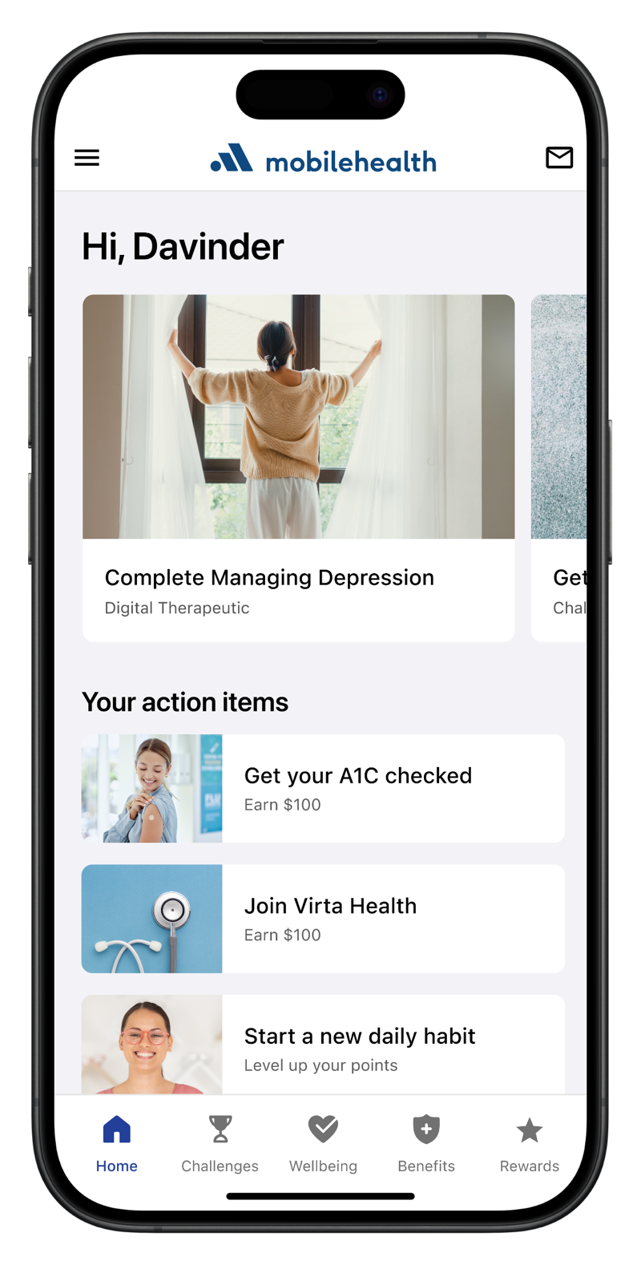


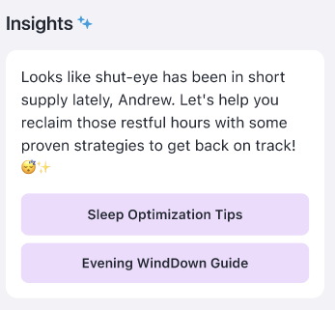
Only Mobile Health uses A.I. to Identify, Engage & Improve health
Identify
Engage
Improve
90%
Improved their health
A.I. API to ChatGPT
A.I. / LLM Digital Care Programs
85%
Would recommend to a friend
Meet Davinder
Health assessment, demographic data, wearables, clinical data
Full time employee
46 Years Old
Has diabetes
Showing signs of depression
Works a sedentary job
Confidential and Proprietary
Notes:
Suggested talk track:
-This kind of engagement doesn’t happen passively — it requires a deliberate move to activate digital-first care.
-Engagement doesn’t happen automatically — it happens when employers activate digital-first care
90% improve health
85
70

Slide 17

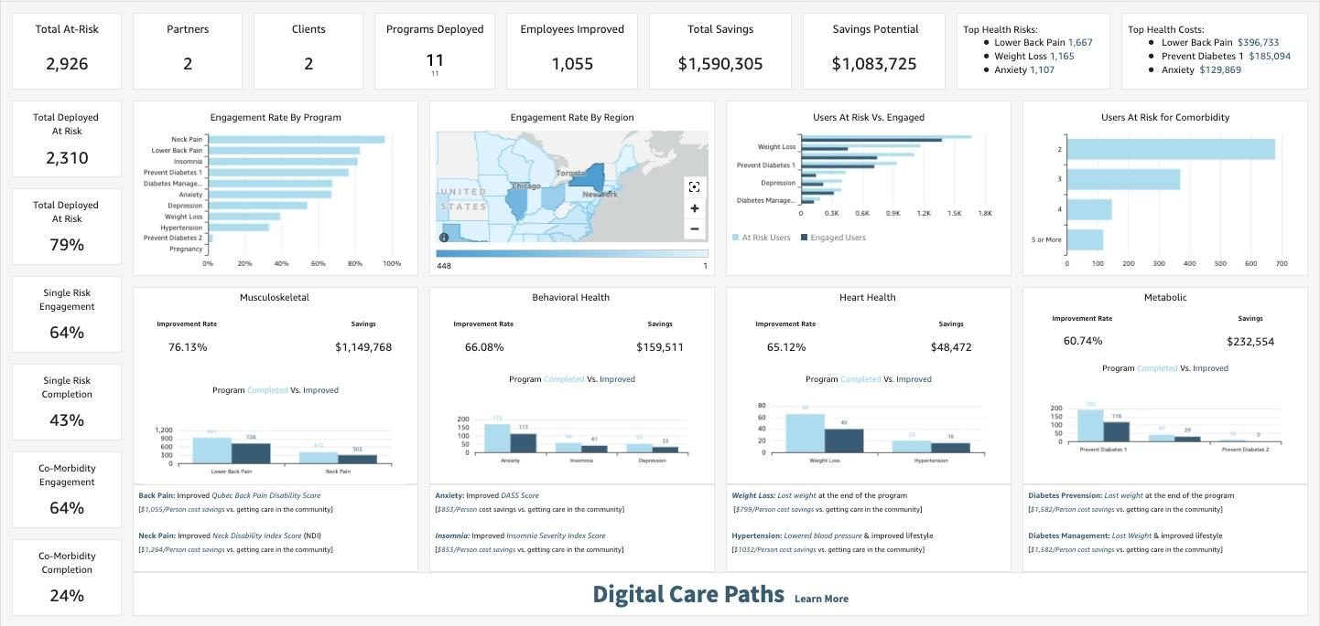
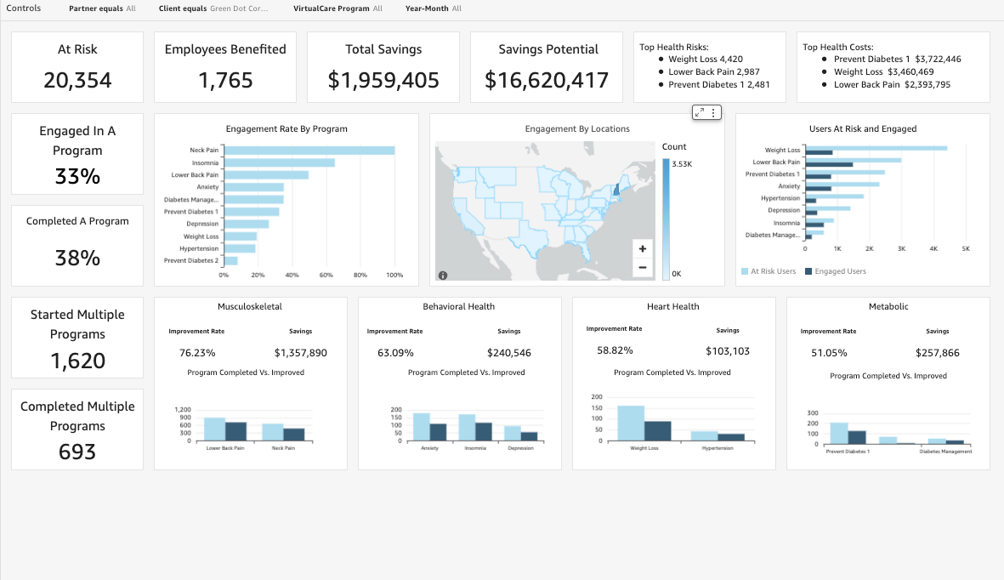
Proven Health Improvement & Real Savings
*Actual client savings achieved by guiding employees to digital-first solutions compared to traditional community-based care.

Slide 18
What’s Inside
Condition Mgt / Digital Care
Wellbeing & Engagement
Behavioral Health
Managing Depression
Managing Anxiety
Treating Insomnia
Substance Misuse
Social Anxiety
Heart Health
Healthy Blood Pressure
Hyperlipidemia
Lung Health
COPD/Asthma
Family Forming
Pregnancy
Postpartum
MSK
Lower Back Care
Neck Care
Knee Care
Hip Care
Shoulder Care
Weight
Weight Management
GLP-1 Support
Diabetes
Diabetes Prevention
Diabetes Prevention Cont.
Diabetes Management
Diabetes Companion
Challenges & Healthy Habits
Physical
Emotional
Financial
Social
Career
Incentives & Rewards
Communications
Aggregation & Personalization
Notes:
Immediate access to care with Digital Care Paths (DCPs) shifts care from costly
community settings—reducing a major driver of overall spend.

Slide 19
Demo

Slide 20
Zero Costs, Zero Friction to Get Started
TRADITIONAL WAY
A BETTER WAY
Fixed PEPM regardless of engagement
Pay via claims only when employees engage
Low engagement with unclear ROI
Pay for outcomes, not access
Extra admin, invoices, and budget headaches
Mobile Health funds the reward for engagement
Why Engagement-Based Billing Works
Costs are directly tied to employee engagement in Digital Care Paths, helping reduce overall healthcare trend, compared to care accessed in the community.
No engagement, no cost
Clearer ROI driven by measurable, behavior-based outcomes
Eliminates or significantly reduces employer incentive budgets
No PEPM pricing—less administration, no financial lift

Slide 21
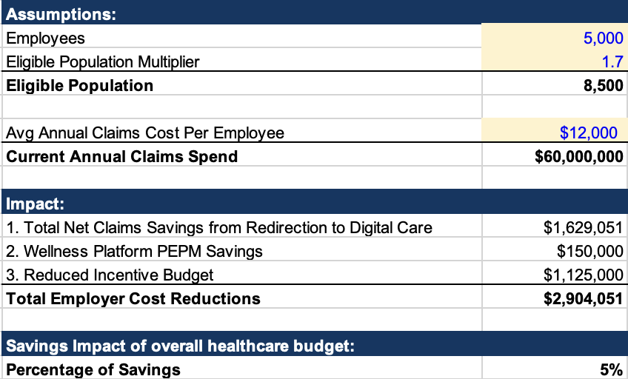
A.I. & Engagement-Based Billing:
Reduce Your Costs by 5% or More Immediately
Change this screenshot
by Prospect

Slide 22
Next Steps

Slide 24
Unused Slides

Slide 25

Mobile Health
Solving the most pressing workforce health challenges
For Members | For Employers
Affordability Guide members to clinically appropriate Digital Care Paths that reduce reliance on higher-cost community care and lower avoidable spend.
Access to care Deliver anytime access to high-quality care at no cost to members while helping employers close gaps in care, especially for those who need it most, with 70%+ engagement.
Engagement Personalized navigation powered by embedded AI and LLM technology turns member touch points into proactive, tailored guidance that drives sustained participation.
Vendor consolidation One integrated platform spanning Behavioral Health, Metabolic Health, Muskuloskeletal, Women’s Health, and more, simplifying administration and reporting.
Notes:
Mobile Health is a single digital platform that acts as the front door to benefits and health programs.
Instead of employees navigating multiple vendors, they have one place to:
Access digital care programs
Receive personalized guidance
Earn incentives
Engage in condition-specific support
Get answers when questions arise
We focus on:
Affordability — reducing unnecessary high-cost care
Access — immediate digital support
Engagement — personalized outreach and guidance
Simplification — consolidating vendors

Slide 26
Needs updating
Add check marks
Mobile Health
Solving the most pressing workforce health challenges
For Members | For Employers
Affordability
Access to care
Engagement
Vendor consolidation
Notes:
Mobile Health is a single digital platform that acts as the front door to benefits and health programs.
Instead of employees navigating multiple vendors, they have one place to:
Access digital care programs
Receive personalized guidance
Earn incentives
Engage in condition-specific support
Get answers when questions arise
We focus on:
Affordability — reducing unnecessary high-cost care
Access — immediate digital support
Engagement — personalized outreach and guidance
Simplification — consolidating vendors

Slide 27
Zero Cost, Zero Friction to Get Started
 | Zero Cost, Zero Friction Option: Engagement Based Billing | Traditional PEPM
What employers pay for | Only pay when users Engage | PEPM
Cost profile | No upfront PEPM for digital care paths | $2.50 - $4.00
Primary benefit | Affordability and adoption | Fixed Monthly Cost
Best for | Employers with Strained PEPM Budgets | Employers that have and want fixed budgets

Slide 28
Mobile Health is the best way to use AI to get Outcomes
 | Direct to ChatGPT | Mobile Health
Pre-Built & Tested User Health Prompts | No | Yes
Accurate User Health Status & Diagnoses | No | Yes
Continuous User Wearable Data Integration | No | Yes
Immediate Activation to A.I. powered Health Management Programs | No | Behavioral Health, Heart Health, MSK, Women's Health
Always-on API Integration | No | Yes
Notes:
Challenge/what’s broken:
Employers are facing another year of elevated cost increases, driven by medical + Rx.
Traditional levers are tapped out leading to diminishing returns and more member friction at renewal.
Affordability and talking about the impact of that. Deferring care. How rate increases have contributed to the problem around affordability.

Slide 29
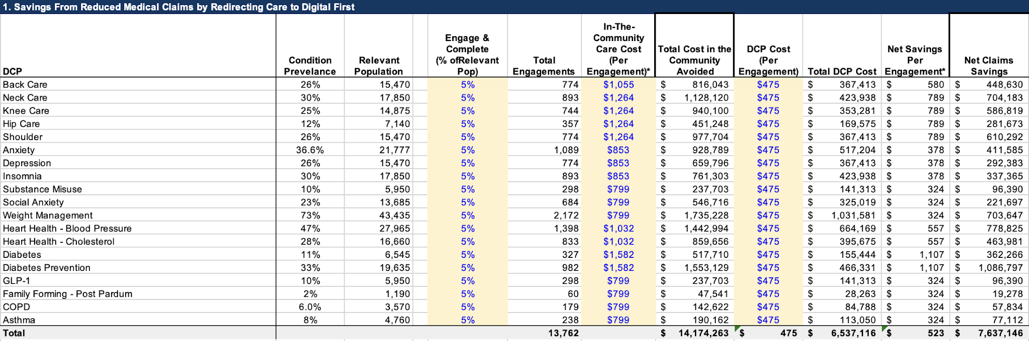
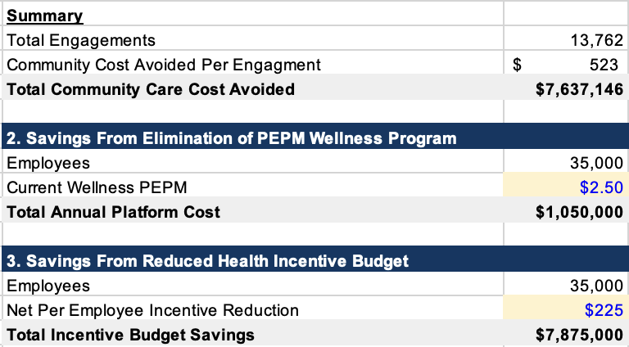
Healthcare Cost Impact
Reps should go into the actual tool when showing this level of detail

Slide 30


The Challenge
53% of Employers exceeded or significantly exceeded their budget
Affordability: Budgets are tightening, forcing employers to cut or delay programs that don’t show immediate value.
Access: Provider shortages and long wait times make it harder for employees to get timely care.
Engagement: Without meaningful engagement, even the right programs fail to impact costs or outcomes.
Notes:
Challenge/what’s broken:
Employers are facing another year of elevated cost increases, driven by medical + Rx.
Traditional levers are tapped out leading to diminishing returns and more member friction at renewal.
Affordability and talking about the impact of that. Deferring care. How rate increases have contributed to the problem around affordability.

Slide 31
The Challenge
53% of Employers exceeded or significantly exceeded their budget
Affordability: Budgets are tightening, forcing employers to cut or delay programs that don’t show immediate value.
Access: Provider shortages and long wait times make it harder for employees to get timely care.
Engagement: Without meaningful engagement, even the right programs fail to impact costs or outcomes.
Notes:
Challenge/what’s broken:
Employers are facing another year of elevated cost increases, driven by medical + Rx.
Traditional levers are tapped out leading to diminishing returns and more member friction at renewal.
Affordability and talking about the impact of that. Deferring care. How rate increases have contributed to the problem around affordability.

Slide 32
The Challenge
53% of Employers exceeded or significantly exceeded their budget
Affordability: Healthcare cost on pace to DOUBLE
Access: 30 day wait
Engagement: Engagement >5%
Notes:
Challenge/what’s broken:
Employers are facing another year of elevated cost increases, driven by medical + Rx.
Traditional levers are tapped out leading to diminishing returns and more member friction at renewal.
Affordability and talking about the impact of that. Deferring care. How rate increases have contributed to the problem around affordability.

Slide 33
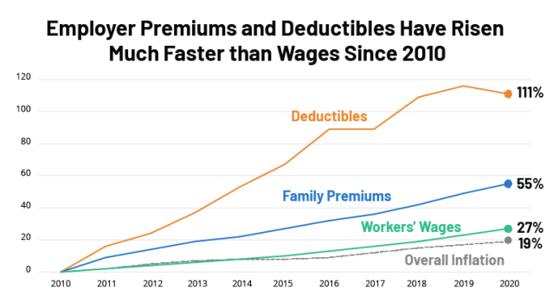
56% of Employees concerned about costs
Strategies tried:
Higher Deductibles
Higher Co-pays
Narrower networks
Restricted formularies
More point solutions
Healthcare Costs will double in 7 years at the current pace again
Notes:
Notes from John:
We want to add:
Even with everything employers, consultants and Healthplans have done - Healthcare is increasingly unaffordable, and is tracking to get worse over time:
Narrow Networks
Restricted Formulary lists, Point Solutions,

Slide 34

As healthcare becomes less affordable and harder to access, employees don’t wait. They self-navigate their health.
Every day, more than 40 million people use AI tools to ask health questions
Self-navigation today lacks:
personal context
trusted guardrails
a clear next step into care
Why activation is the missing link
Activation is what turns questions into care.
Notes:
40 million people everyday are using ChatGPT to self diagnose but they don’t know what to do next. #1b366c

Slide 35


Addressing what matters most
to employers and employees
I like it - wish we could do it w less words
Affordability and Accessibility
Right care, right time
Engagement and Behavior Change
70%+ engagement, especially where it matters most
Pricing Flexibility
PEPM or engagement-based pricing
Reducing Trend
Targeting high-cost drivers
GLP-1, MSK, mental health, prevention

Slide 36
Your bold move
Actions you can take to activate digital-first care
Increase engagement in programs that save money
Drive activation and completion using Mobile Health navigation, journeys, and incentives
1
Add programs in top spend areas
Deploy Digital Care Paths (DCPs) across MSK, Behavioral Health, and weight/GLP-1 support
2
Deploy a digital-first front door
No added complexity or risk—easy for HR to implement; proven results.
3
Renewal Cost Impact: 4-6%
Notes:
3. No complexity, no risk. Easy for HR. This is easy to sell. It works.

Slide 37

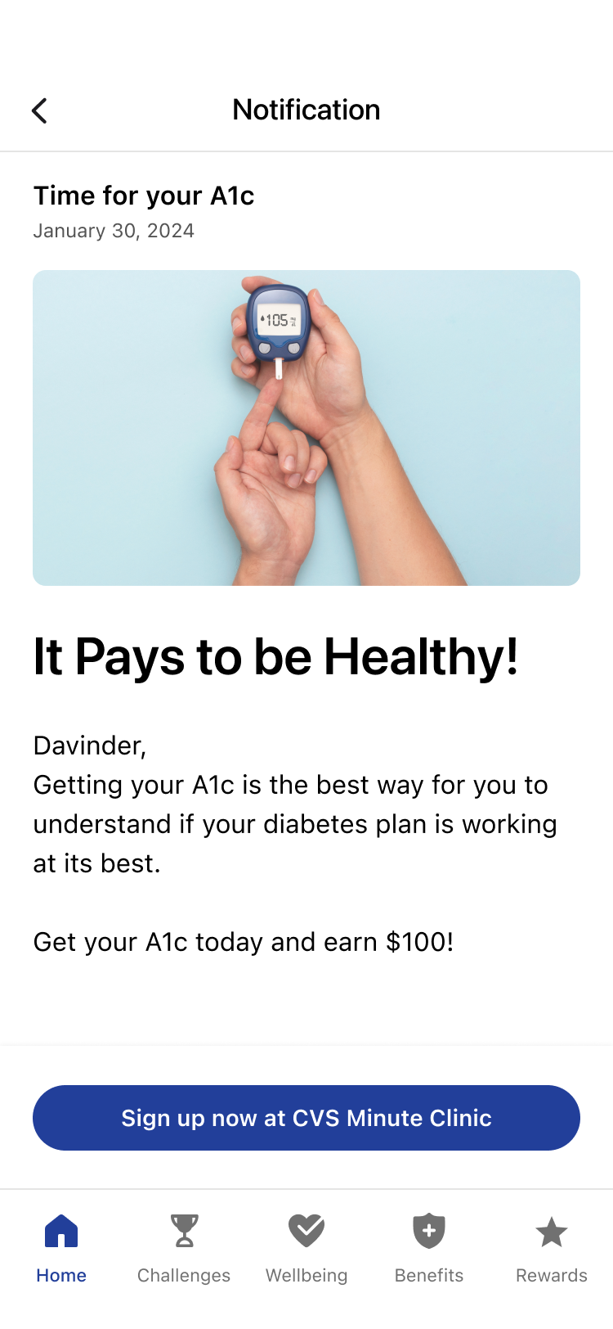
The impact of digital-first care.
High Engagement
Members actively use Digital Care Paths (DCPs) and highly value the experience—86% recommend and 98% say they learned.
Improved Health Outcomes
DCPs deliver measurable improvement across conditions, including 80% back pain, 74% hypertension, and 71% neck pain.
Lower Total Cost
With 60–70% engagement, DCPs shift care from the community to digital, lowering costs and supporting renewals.
Notes:
Mobile Health makes it easy for employees to get personalized, high-quality digital care so employers and health plans can achieve better results with no upfront barriers.

Slide 38


Built to perform.
How it works
Real-world impact
Launch an employer-branded front door for benefits and programs.
Drive adoption with AI-powered engagement (personalization, rewards, outreach).
Result: 65%–95% engagement, including spouses.
Activate digital-first care paths across high-cost areas to redirect community care.
Flexible funding with faster start (PEPM or engagement-based billing; activate anytime).
Prove impact in real time with analytics tied to ongoing claims data.
Jumbo employer: 70% engagement among employees with BMI > 28; 8 lbs average weight loss using a digital care path.
Public sector employer: saved $1.1M by redirecting employees to digital-first care; $0 employee cost, immediate access, improved health for 90% of users.
These results are driven by engagement and unlocked by flexible pricing models.
Notes:
How it works and who it works for.
How it works:
First, we create an Employer Branded Front door to all Employer programs
Then, we add A.I. personalization, aggregation, targeted rewards, outreach, team wellbeing challenges & content
this achieve 65% - 95% population engagement including spouses
Then, we deploy Digital First Care Paths for the top Employer cost drivers: Metabolic Health, Behavorail Health, MSK, Womens Health
Finally, we give the employer the choice of NO PEPM/Bill per usage of Digital Care programs, or traditional PEPM
or
Elevance adds a tile to Sydney so Employers can get started with Digital First Care anytime and turn on Digital First Care for their Employees and not wait for their renewal.
Continuous Visibility - Employer Analytics calculates the saving from redirecting to Digital First Care in Real time. We receive claims from users everyday from Elevance, so we are always current
Who its working for, real clients, real results:
Raytheon / RTX had 70% engagement of employees with >28 BMI and the average weight loss with 8 pounds using Digital Care pathe
State of New Hampshire has save $xxM by redirecting employees to Digital First Care. Which has no employee cost, is immediately available and improved health for 90% of users
State of Indiana - Strengthening and improving Engagement
Left side: employer branded front door
Right side:
Ask Darcy for Aya side by side

Slide 39

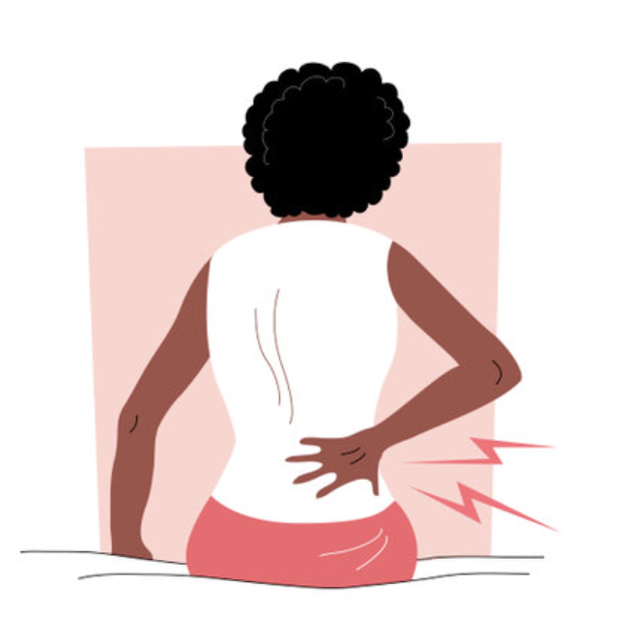

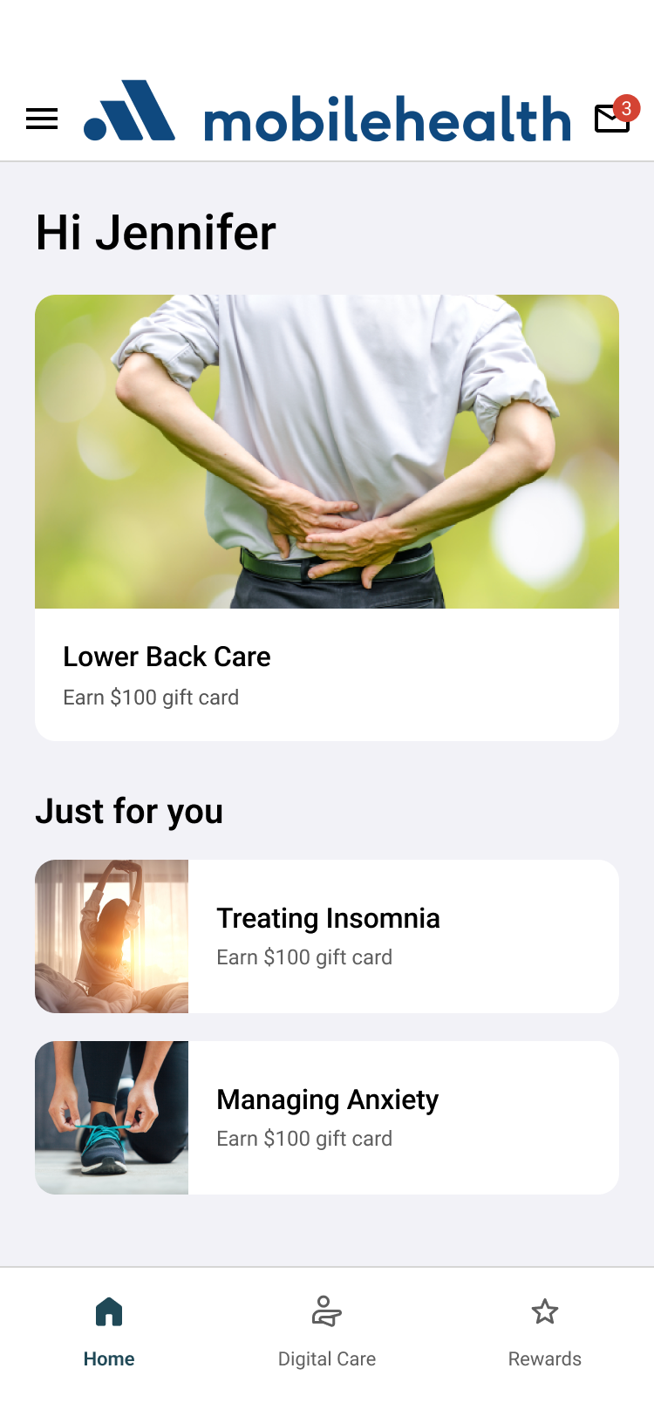
What this looks like in practice.
Immediate access to coordinated care across conditions leads to improved health outcomes
Meet Jennifer
34 • Remote Marketing Manager
Before digital-first care:
Chronic lower back pain
Ongoing anxiety
Persistent insomnia
Three connected conditions. One overwhelmed person.
After digital-first care:
Meaningful pain reduction
Reduced anxiety
Improved sleep
Three coordinated care paths. One supported member.
Notes:
THE TRANSFORMATION
Jennifer started all three programs the same week. What struck her first was how they acknowledged the connections between her conditions. The Lower Back Care program included modules on sleep positioning and stress management. Treating Insomnia addressed the rumination cycle that kept her awake. Managing Anxiety helped her recognize how pain catastrophizing—expecting the worst—was amplifying her physical symptoms.
She did the movement sequences from Lower Back Care every morning before sitting down at her desk—just 12 minutes—and set up a proper workstation using the ergonomic guidance in the program. Sleep restriction therapy felt counterintuitive but worked—within three weeks, she was getting six consolidated hours instead of fragmented sleep.
Within six weeks, her pain dropped from a daily 7/10 to a manageable 3/10. Her anxiety, while still present, felt controllable. She completed all three programs and earned $300 in gift cards, which she used for a proper ergonomic chair.
Jennifer quote: "Traditional care wanted to treat three separate problems with three separate providers. This treated ME—one person whose problems were all connected."

Slide 40

How employers get started.
Wellbeing & Rewards
Digital Care Paths (DCP)
Flexible Option
Per-employee, per-month
You pay a predictable monthly rate for access across all employees
Per-employee, per-month
You pay a monthly rate for access to digital care
Engagement-Based
Digital Care
No monthly fee for DCP
You only pay when employees actively use care
When PEPM pricing is a barrier, engagement-based billing unlocks adoption
Pricing varies based on scope, population size, and configuration.
Notes:
DCP billed based on engagement (not eligible lives)
DCP $1.50 PEPM is waived when specific deployment requirements are met
Includes $100 incentive for program completion
Enables risk stratification + targeted employee communications
Best when the employer prefers to pay for outcomes/usage vs. access
Option 3 — Engagement-Based Digital Care
DCP via EBB (DCP PEPM waived)
Waive $1.50 DCP PEPM when: • Behavioral Health + Muskuloskeletal + Heart Health deployed • $100 completion incentive • Risk stratify + communicate to employees

Slide 41
How employers get started.
Per-employee, per-month (PEPM)
Flexible Option
Includes Wellbeing & Rewards + Digital Care Paths (DCP)
Fixed, predictable monthly cost
Access across eligible employees
Supports rewards, engagement, and digital care paths
Engagement-Based
Digital Care
No monthly fee for DCP
You only pay when employees actively use care
When PEPM isn’t the right fit, engagement-based billing unlocks adoption
Pricing varies based on scope, population size, and configuration.
Notes:
DCP billed based on engagement (not eligible lives)
DCP $1.50 PEPM is waived when specific deployment requirements are met
Includes $100 incentive for program completion
Enables risk stratification + targeted employee communications
Best when the employer prefers to pay for outcomes/usage vs. access
Option 3 — Engagement-Based Digital Care
DCP via EBB (DCP PEPM waived)
Waive $1.50 DCP PEPM when: • Behavioral Health + Muskuloskeletal + Heart Health deployed • $100 completion incentive • Risk stratify + communicate to employees

Slide 42

What does a typical member journey look like?
Meet Jennifer
34 • Remote Marketing Manager
Chronic lower back pain
Ongoing anxiety
Persistent insomnia
Three connected conditions. One overwhelmed person.
Notes:
The Traditional Path: "The Fragmented Maze"
Step 1: The Gatekeeper. Member visits their PCP. They are given a prescription for Ibuprofen and told to "give it two weeks."
Step 2: The Referral Gap. Pain persists. Member calls the recommended Orthopedist; the first available slot is 6 weeks away.
Step 3: The Diagnostic Loop. Specialist orders an MRI ($). Member waits another week for results. Findings are "age-appropriate wear," but the member is now fearful of moving.
Step 4: The PT Logistics. Member starts Physical Therapy 2x/week. They have to leave work early, fight traffic, and pay a $60 co-pay each time.
Step 5: The Complication. Because the back still hurts, the member stops sleeping. Anxiety spikes. They go back to the PCP for sleep meds, adding a third "silo" to their care.
Step 6: Attrition. By week 4, the cost and time commitment become too much. The member stops going to PT, and the pain eventually returns.

Slide 43
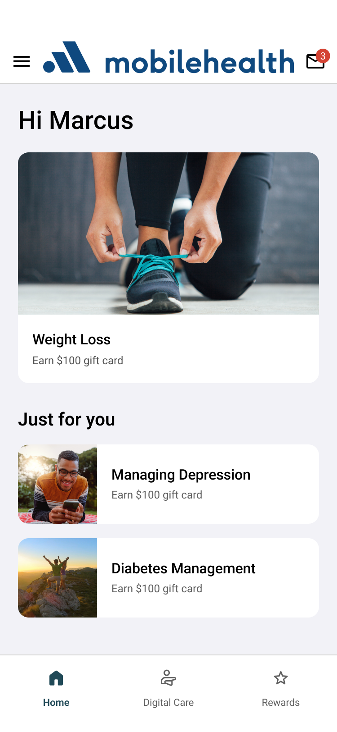
Meet Marcus
Hold for use case on Marcus
Conditions:
Weight loss
Managing depression Diabetes management

Slide 44
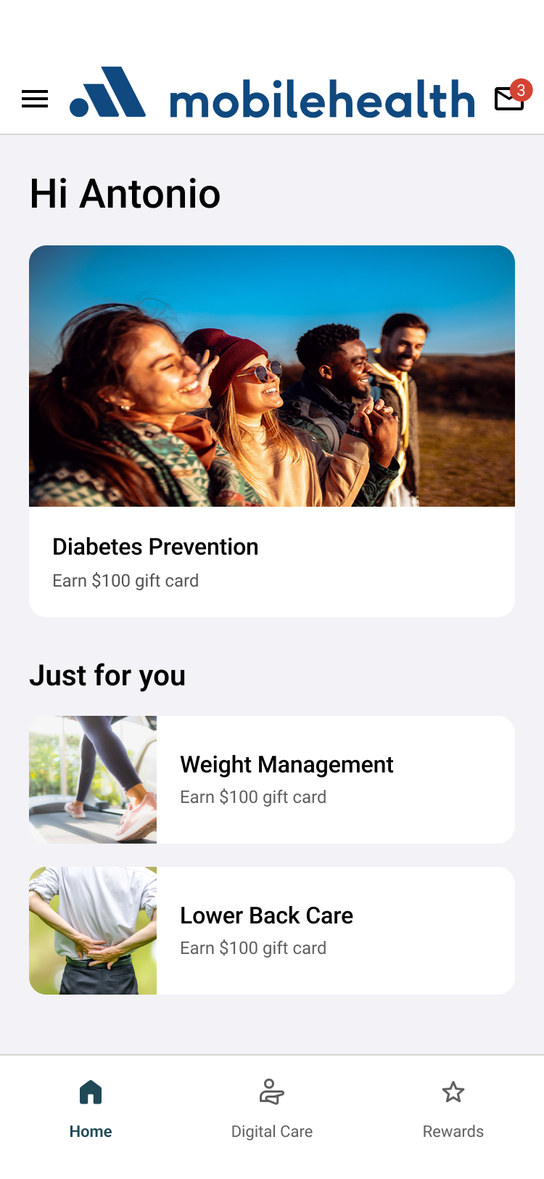
Meet Antonio
Hold for use case on Antonio
Conditions:
Diabetes Prevention
Weight Management
Lower Back Care

